Slide 1
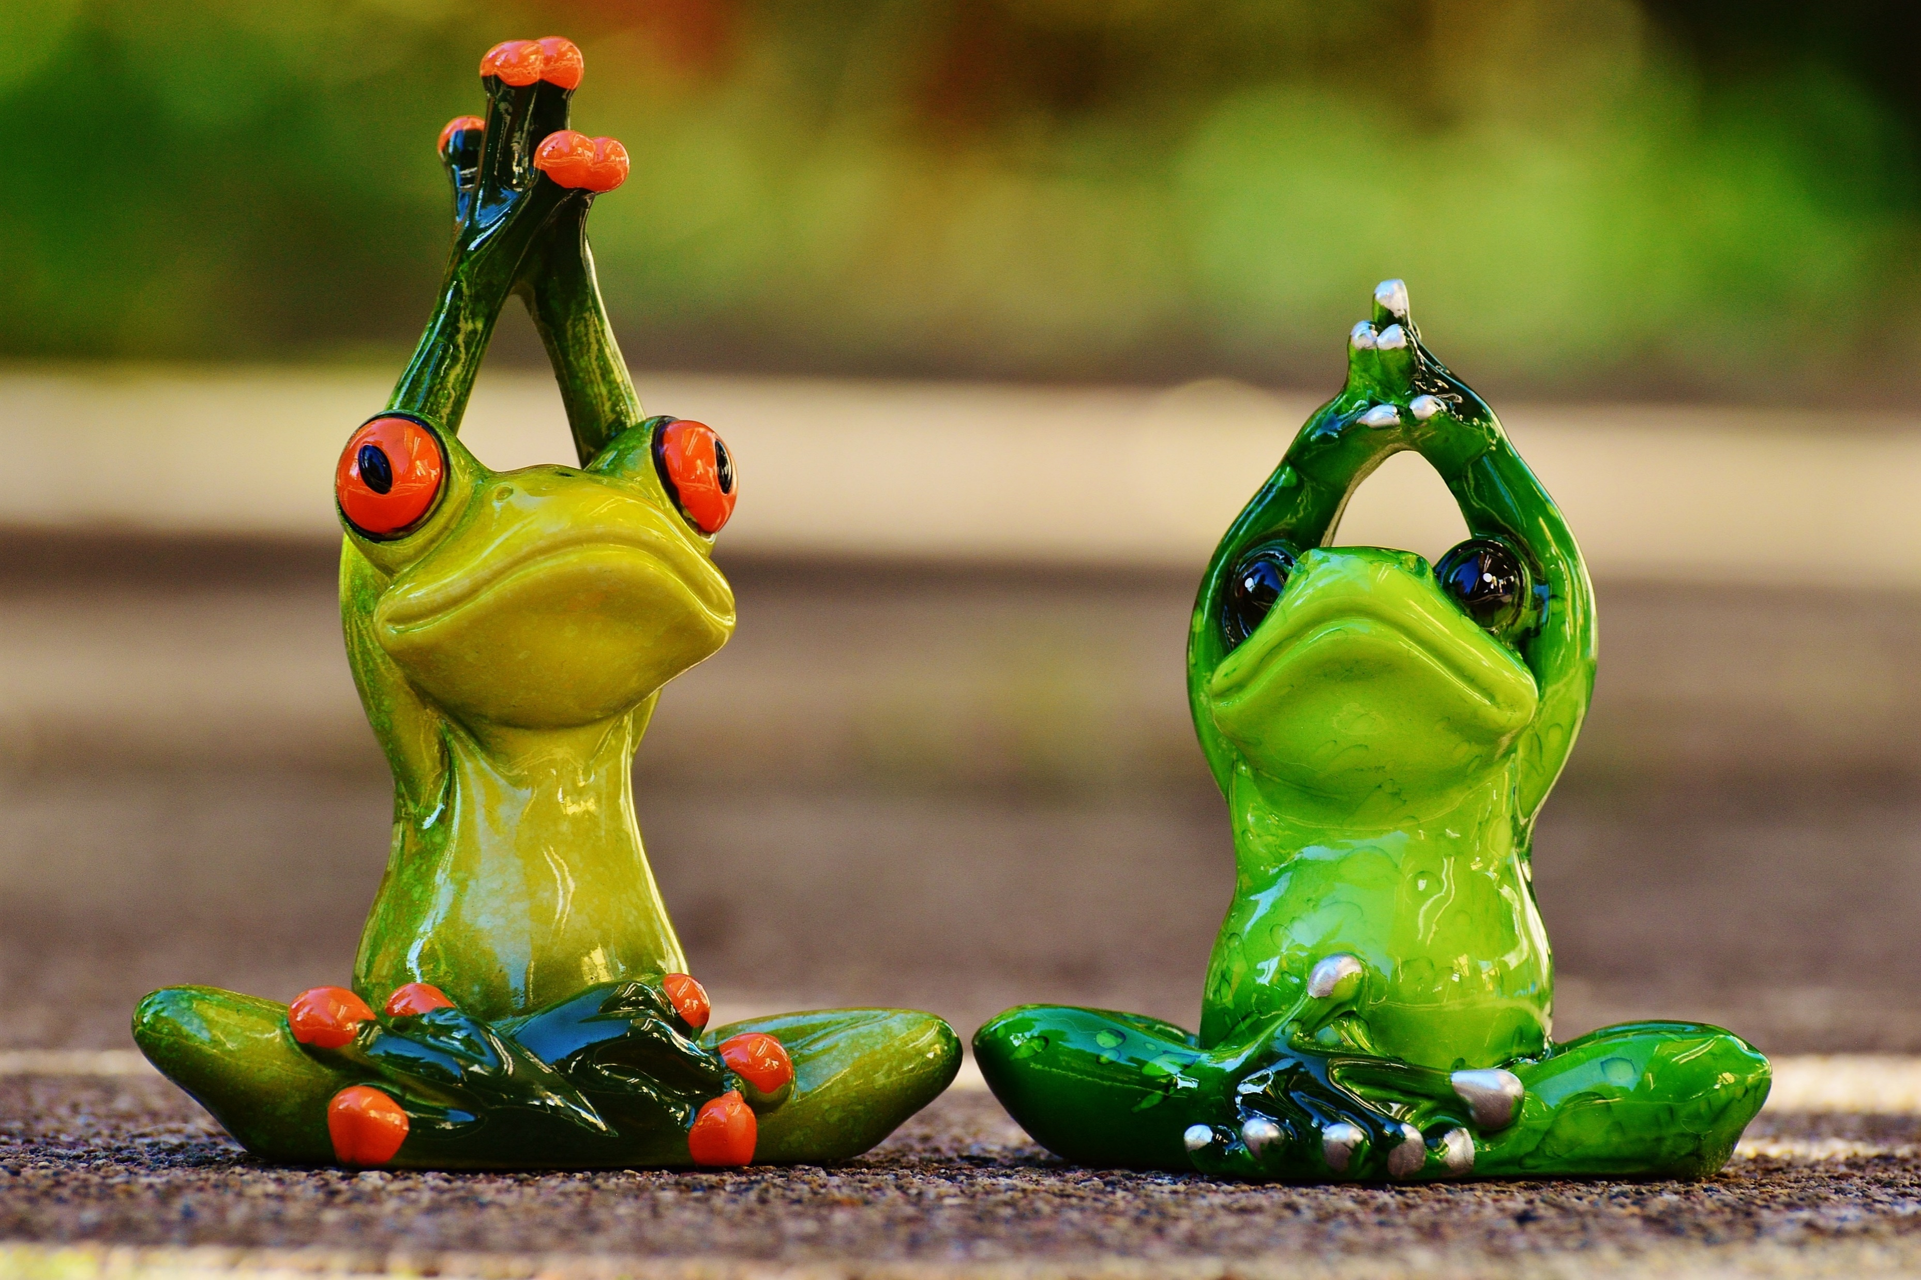
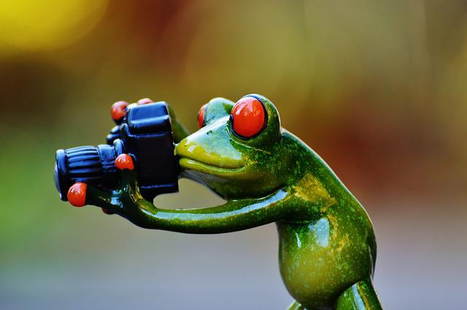
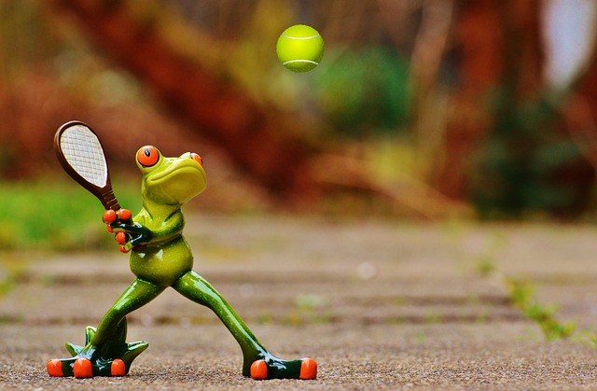

Automated Image captioning
Group 3
Sujatha Kancharla
Monica Nukarapu
Suhail Pasha
Yoga for ….
Trick Photography…
Chaitanya Harkara
Mentor
Nayan Jha
Tennis at …
Tennis at …
Make money when…
Tennis at …

Slide 2
Agenda
Problem Statement
Problem statement
Architecture
Base Model1 – InceptionV3 + LSTM
Base Model2 – ResNet50 +LSTM
Solution - Model
Architecture
Results
Learnings and Next steps

Slide 3
Understanding the problem
Problem Statement
Automated Image Captioning using AIML
Automated Image captioning involves in creating an automated caption for an Image by deriving the best context of the contents of the image.
Broadly the solution should
Identify multiple objects within the image
Derive the relationship between the objects in the image based on their attributes
Derive the caption based on the derived context of the image in Natural language (English)
Key Requirements
Tools : Natural Language Toolkit, TensorFlow, PyTorch, Keras
Deployments: FastAPI, Cloud Application Platform | Heroku, Streamlit, Cloud Computing, Hosting Services, and APIs | Google Cloud
Technology

Slide 4
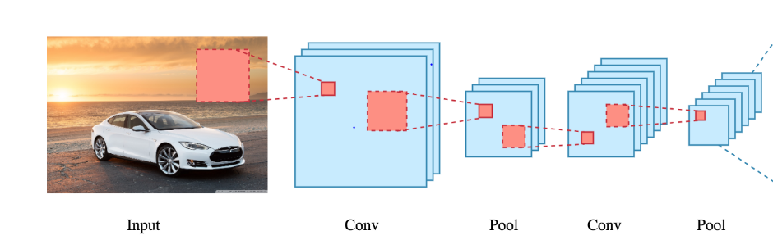
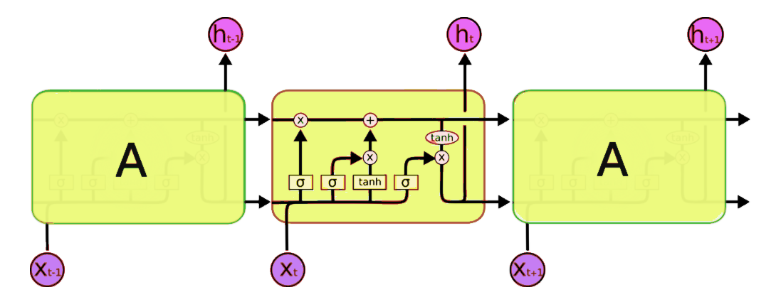
Architecture – Automatic Image Captioning Based on InceptionV3 and LSTM
Word
Word
Word
Caption
Features
InceptionV3 - CNN(Encoder)
LSTM(Decoder)
Reference
NIC is based end-to-end on a neural network consisting of a vision CNN followed by a language generating RNN
Inspiration
Text Transitions of RNN
RNN Encoders converting Text to Rich Vector representation
RNN Decoders generating Target Sentence
Summary
CNN as Encoder for providing rich Vector representation of image (last hidden layer from a pretrained classifier)
RNN Decoders generating Target Sentence

Slide 5
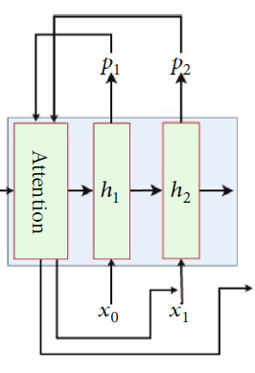
Base model2 – Automatic Image Captioning Based on ResNet50 and LSTM
Caption
1D Vector
ResNet50(Encoder)
LSTM(Decoder)
Reference
AICRL is based end-to-end on a neural network consisting of a RESNET50 CNN followed by a language generating RNN
Inspiration
Adding attention layer on ResNet50 significantly improved the description accuracy
Summary
Extract visual features, which use ResNet50 network as the encoder to generate a one-dimensional vector representation of the input images
Soft Attention mechanism

Slide 6
Base model1- Implementation using InceptionV3
Pre- Processing
Feature Engineering
Pick Model & Hyper Parameters
Model Training and Optimization
Evaluate Model
Deploy on Server
Integrate and Test
Read the Annotations and Image data mapping from Flickr8k_Text to build Input – Image and Corresponding Caption(s)
Image Feature extraction using pretrained InceptionV3 to a 1D Vector (299,299) to (2048,)
Dictionary based on Glove 200 attribute word embedding from Stanford.edu
Soft Attention to extract more relevant feature of the image
InceptionV3 - 1D - ( 2048,)
Keras/Pytorch based Model
LSTM
Cross Entropy Loss Function , Adam
Hyper parameters – determined Iteratively
Hyper parameters Learning Rate , Epochs, Batch Size, Drop out derived iteratively
X train = Image (6000)
Y Train = Caption derived from Pre-processing and feature engineering
1000 images (dev) and captions
1000 images (Test) and captions
Captions and ratings provided in Flickr8k_Text
Rating Standard BLEU
Compare the outcome from LSTM Vs Rated Image caption data using BLEU rating standard
FastAPI/Heroku
Cloud Computing
Hosting Services
API
Test model using 1000 test images
Check the rating of the Test images
User Input
Test the caption generated for image as User input provided on a Web page
Key Steps
Inputs
Files
Flickr8k.token
Flickr_8k.trainImages
InceptionV3 Model
LSTM
Glove Word Embedding (200)
Optimizer
LSTM Implementation
Flickr8k_Text
Flickr8k_Text
BLEU
BLEU
Flickr8k_Text
BLEU

Slide 7
Base model2- Implementation using ResNet50
Pre- Processing
Feature Engineering
Pick Model & Hyper Parameters
Model Training and Optimization
Evaluate Model
Deploy on Server
Integrate and Test
Read the Annotations and Image data mapping from Flickr8k_Text to build Input – Image and Corresponding Caption(s)
Image Feature extraction using pretrained Resnet50 to a 1D Vector (229,229,3) to (2048,)
Dictionary based on Glove 200 attribute word embedding from Stanford.edu
Soft Attention to extract more relevant feature of the image
ResNet50 - 1D -
( 2048,)
Keras/Pytorch based Model
LSTM
Cross Entropy Loss Function , Adam
Hyper parameters – determined Iteratively
Hyper parameters Learning Rate , Epochs, Batch Size, Drop out derived iteratively
X train = Image (6000)
Y Train = Caption derived from Pre-processing and feature engineering
1000 images (dev) and captions
1000 images (Test) and captions
Captions and ratings provided in Flickr8k_Text
Rating Standard BLEU
Compare the outcome from LSTM Vs Rated Image caption data using BLEU rating standard
FastAPI/Heroku
Cloud Computing
Hosting Services
API
Test model using 1000 test images
Check the rating of the Test images
User Input
Test the caption generated for image as User input provided on a Web page
Key Steps
Inputs
Files
Flickr8k.token
Flickr_8k.trainImages
ResNet50 Model
LSTM
Glove word embedding(200)
Optimizer
LSTM Implementation
Flickr8k_Text
Flickr8k_Text
BLEU
BLEU
Flickr8k_Text
BLEU

Slide 8
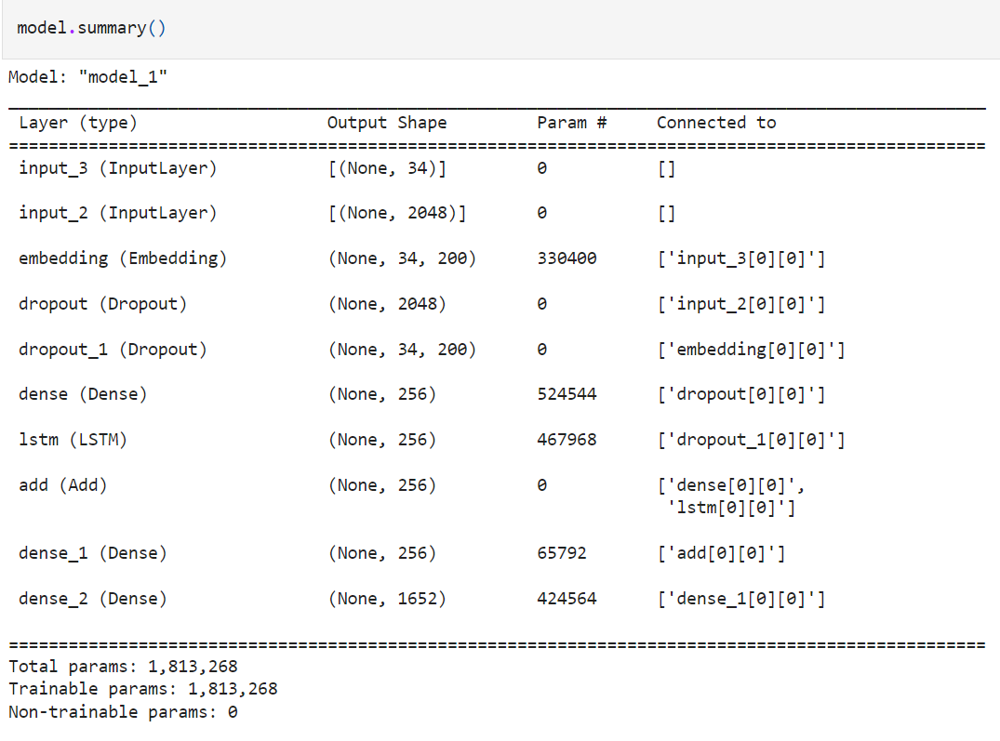
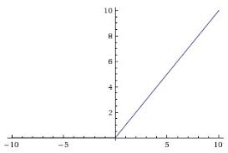
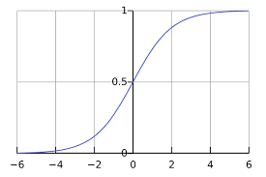
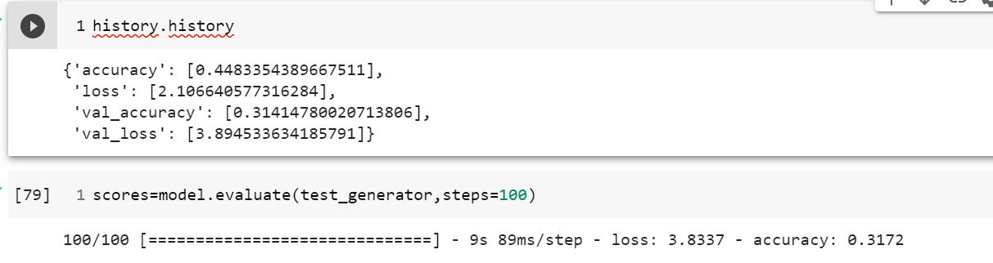
Base model1- Implementation using InceptionV3
Encoder(InceptionV3)
Decoder
Flickr8
InceptionV3
Drop out+ Dense
299,299
2048,
256
LSTM(256)
Dense(256)
Dense(1652)
Image
Relu
Word Embedding(Glove)
Loss - Cross Entropy
Optimizer - Adam
Caption Data
Glove Word Embedding
Drop out
Epochs – 45
Learning rate – 0.0001
34 word Max
1652, 200
256
Relu
Softmax
Efficacy Measurement – BLEU ( Trigram)
1652 >10 rep words
Bleu score
No of Images | Average BLEU Score (>=0.1) | #BLEU Score (<0.1)
200 | 46(0.21) | 154

Slide 9
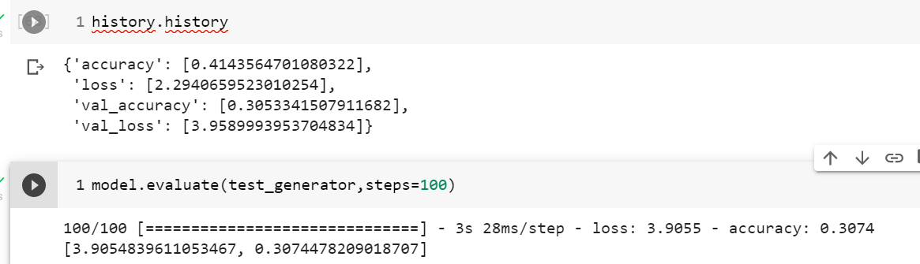
Base model2- Implementation using ResNet50
Encoder(ResNet50)
Decoder
Flickr8
Flickr8
Flickr8
ResNet50
ResNet50
ResNet50
Drop out+ Dense
Drop out+ Dense
229,229,3
2048,
256
LSTM(256)
Dense(256)
Dense(1652)
Image
Relu
Word Embedding(Glove)
Loss - Cross Entropy
Optimizer - Adam
Caption Data
Glove Word Embedding
Drop out
Epochs – 45
Learning rate – 0.0001
34 word Max
1652, 200
256
Efficacy Measurement – BLEU ( Trigram)
Relu
Softmax
1652 >10 rep words
Bleu score
No of Images | Average BLEU Score (>=0.1) | # BLEU Score (<0.1)
200 | 49(0.234) | 151

Slide 10
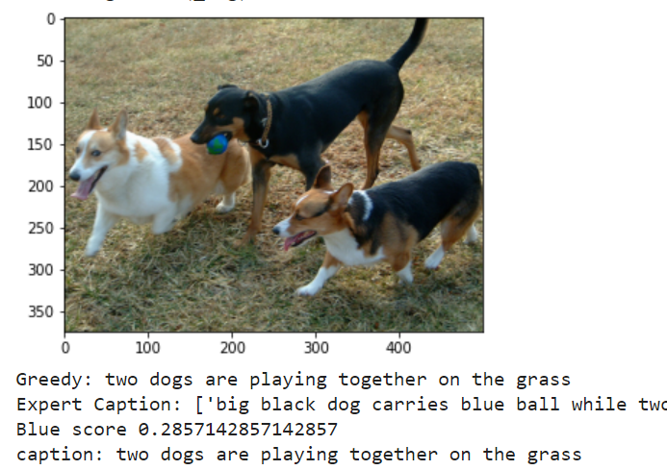
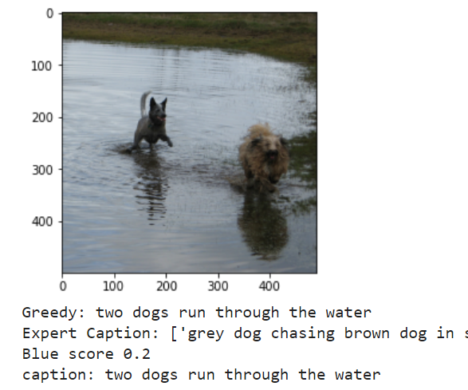
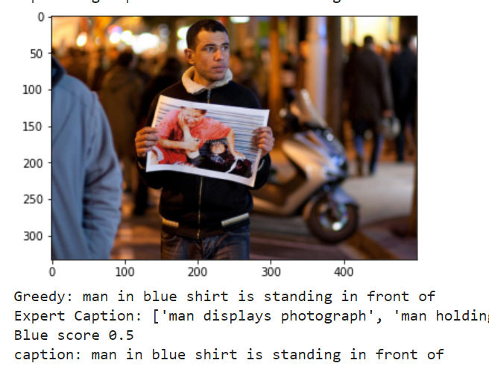
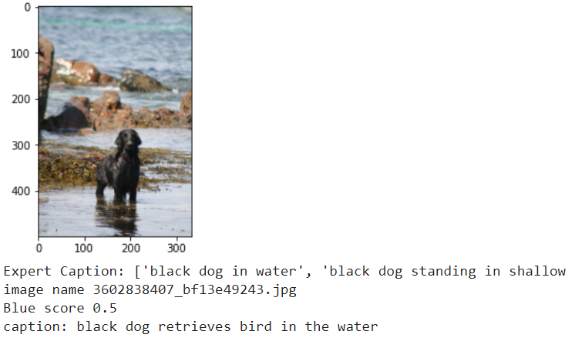
Output captions – InceptionV3

Slide 11
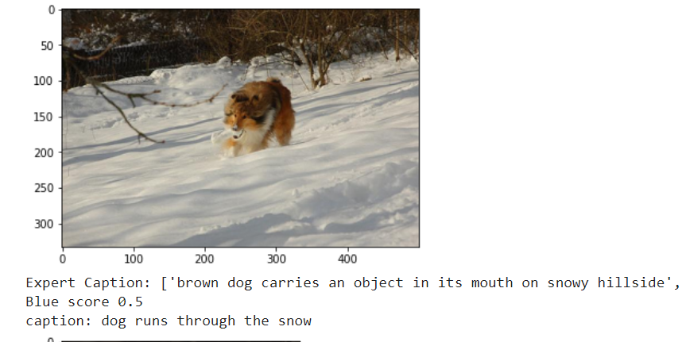
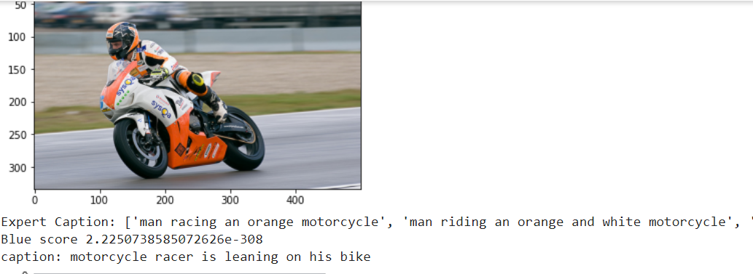
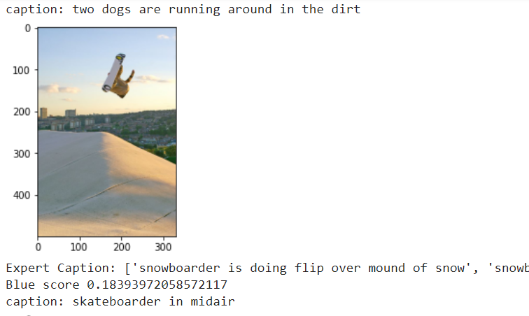
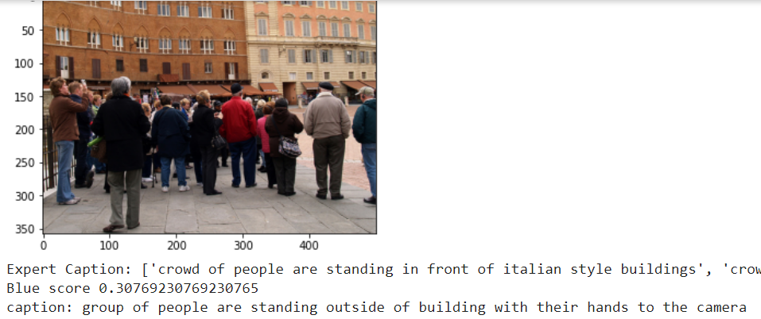
Output captions - ResNet50

Slide 12
Learnings and Next steps
Learnings
Next Steps
To look for better validation model than Bleu score
Captions evaluation using Bleu score based on Expert caption vs prediction is not high
Captions seem to be less accurate if more objects and back grounds are involved
Predicted captions with low Bleu score seem appropriate
Captions generated from such model will have words only limited to training dataset which means model may not generate captions for images with new content.
Other Decoder(s)
LSTM Attention
Transformers
Other Pre-Trained CNN ( Encoder) Models
GoogleNet
Other Decoder Models (Word Embeddings)
Word2Vec
BERT
Data
COCO

Slide 13
Thank You!!

Slide 14
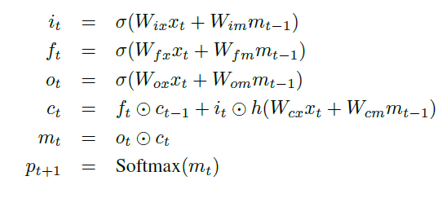
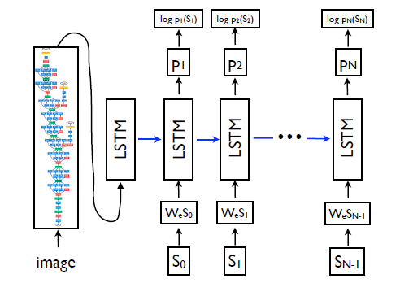
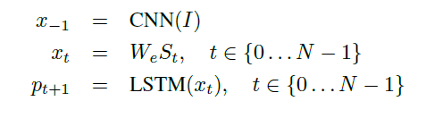
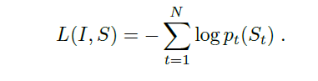
Model - LSTM
Input gate
LSTM Gates
Forget gate
Output gate
Word prediction
Context
Probability
Image Vector from CNN
End to End
Word Embedding
Loss function

Slide 15
Architecture – Keras Implementation
inputs1 = Input(shape=(2048,))
fe1 = Dropout(0.5)(inputs1)
fe2 = Dense(256, activation='relu')(fe1)
inputs2 = Input(shape=(max_length,))
se1 = Embedding(vocab_size, embedding_dim, mask_zero=True)(inputs2)
se2 = Dropout(0.5)(se1)
se3 = LSTM(256)(se2)
decoder1 = add([fe2, se3])
decoder2 = Dense(256, activation='relu')(decoder1)
outputs = Dense(vocab_size, activation='softmax')(decoder2)
model = Model(inputs=[inputs1, inputs2], outputs=outputs)

